Slide 1
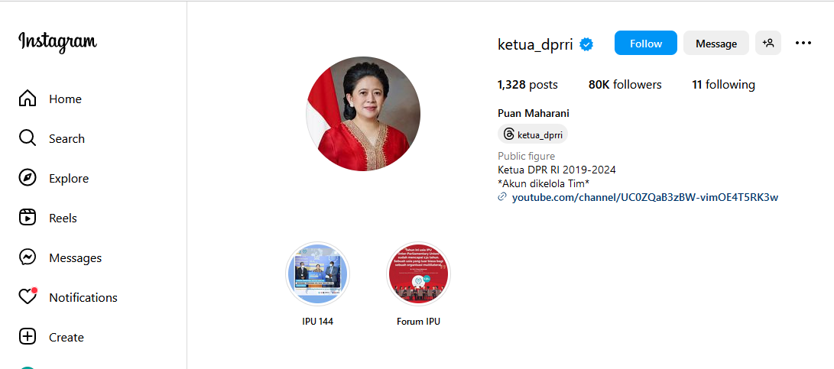

Slide 2
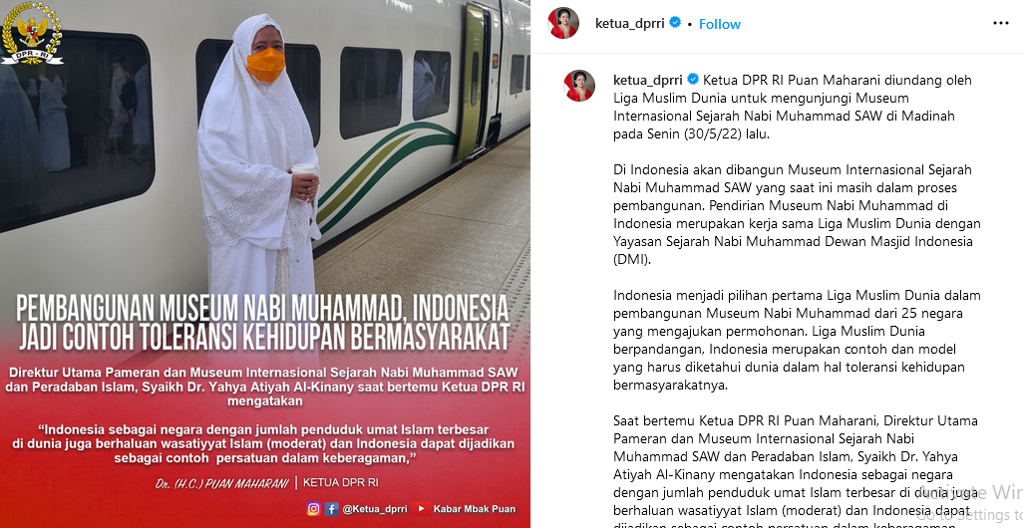

Slide 3
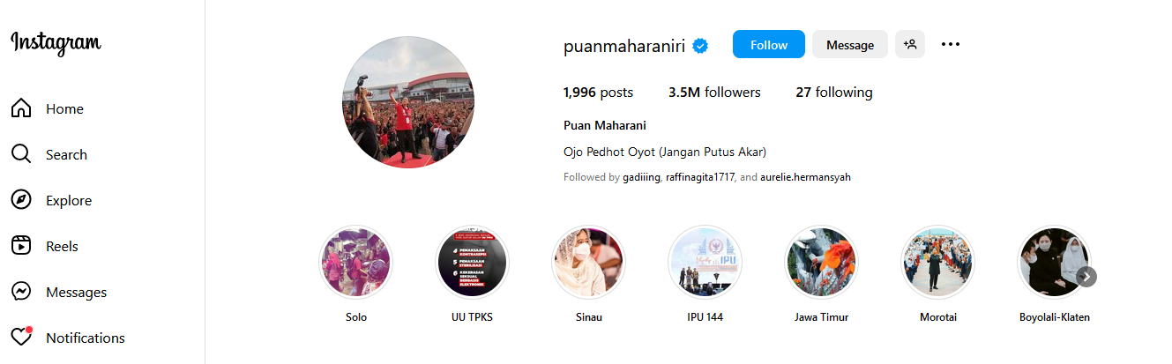

Slide 4
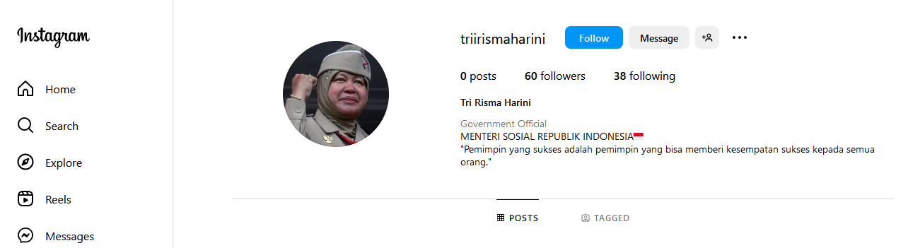
https://www.instagram.com/triirismaharini/

Slide 5
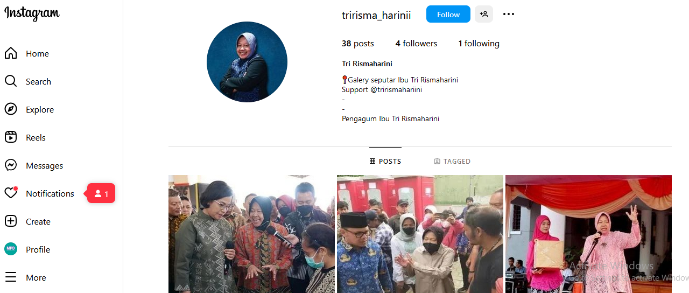
https://www.instagram.com/tririsma_harinii/

Slide 6
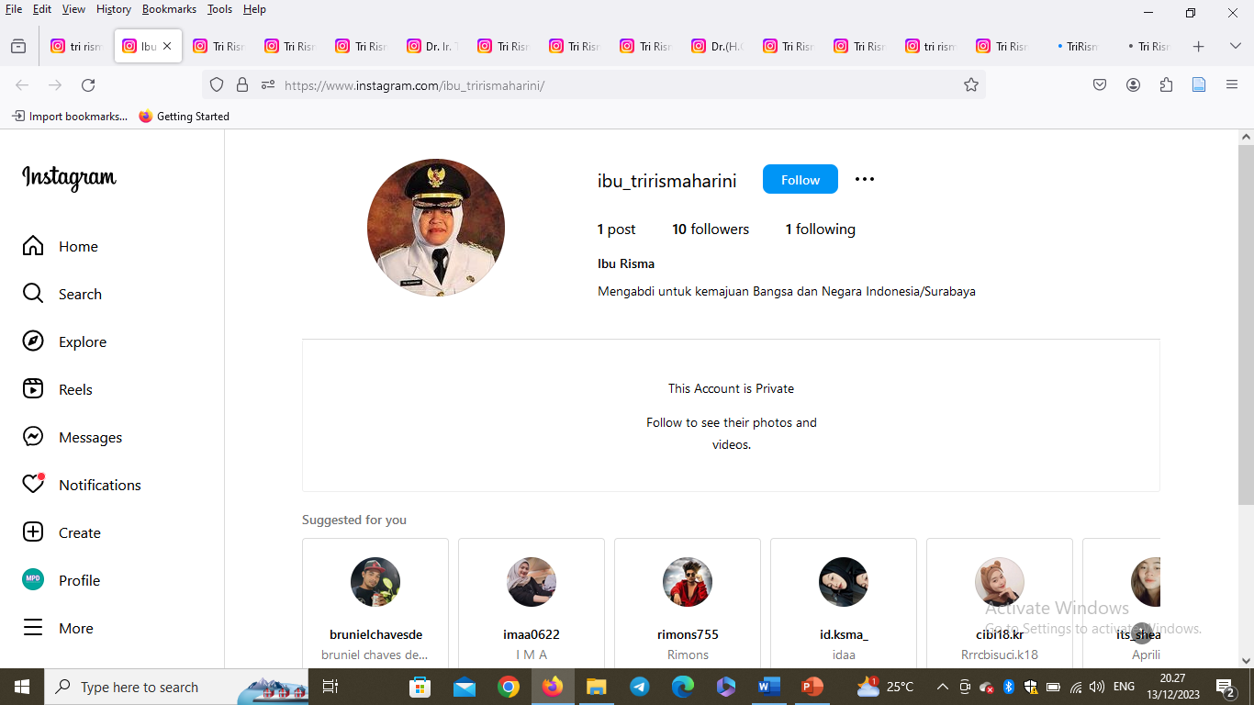
https://www.instagram.com/ibu_trirismaharini/

Slide 7
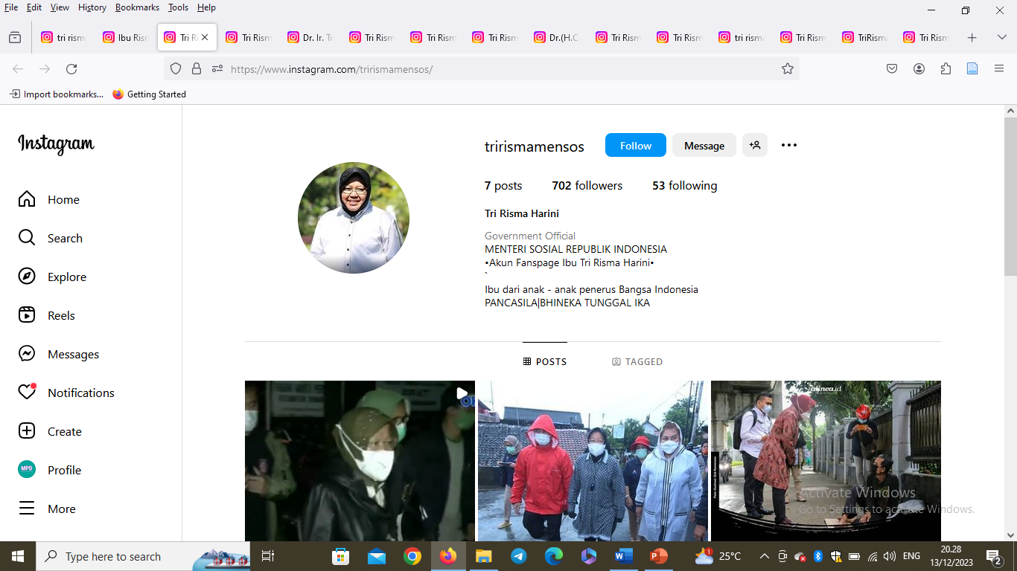
https://www.instagram.com/trirismamensos/

Slide 8
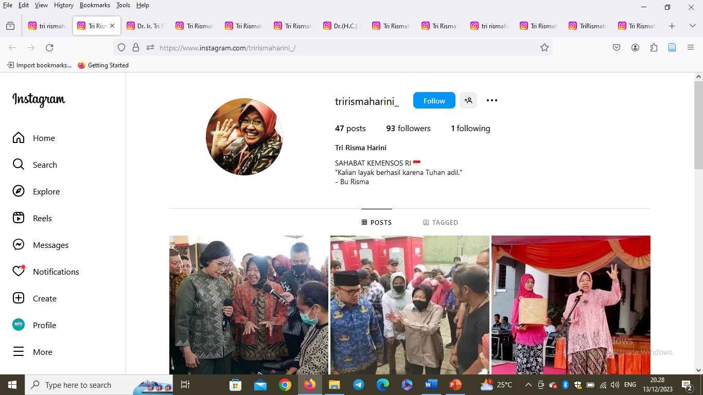
https://www.instagram.com/trirismaharini_/

Slide 9
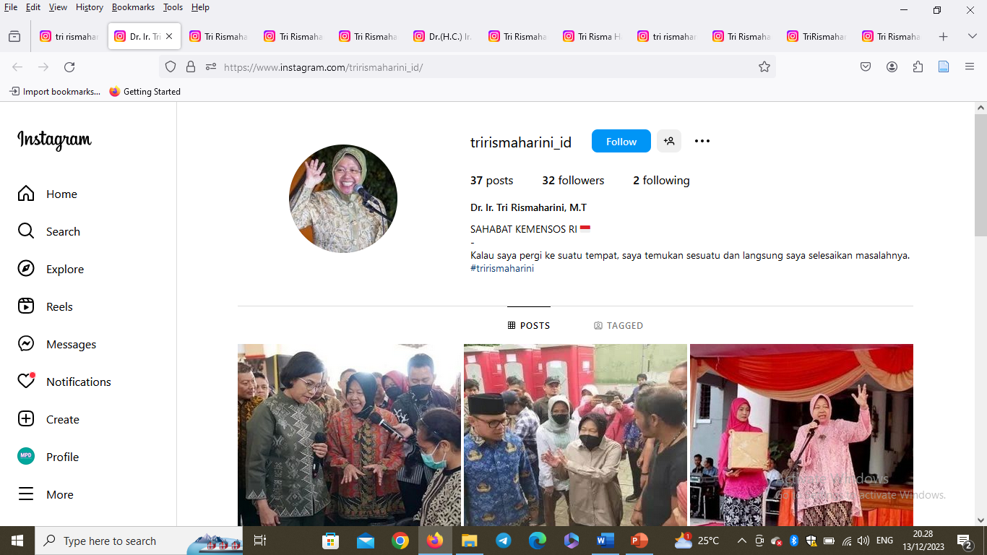
https://www.instagram.com/trirismaharini_id/

Slide 10
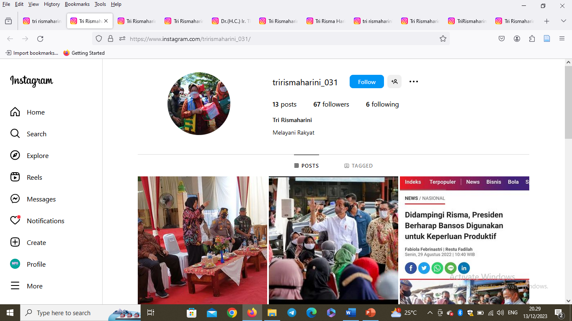
https://www.instagram.com/trirismaharini_031/

Slide 11
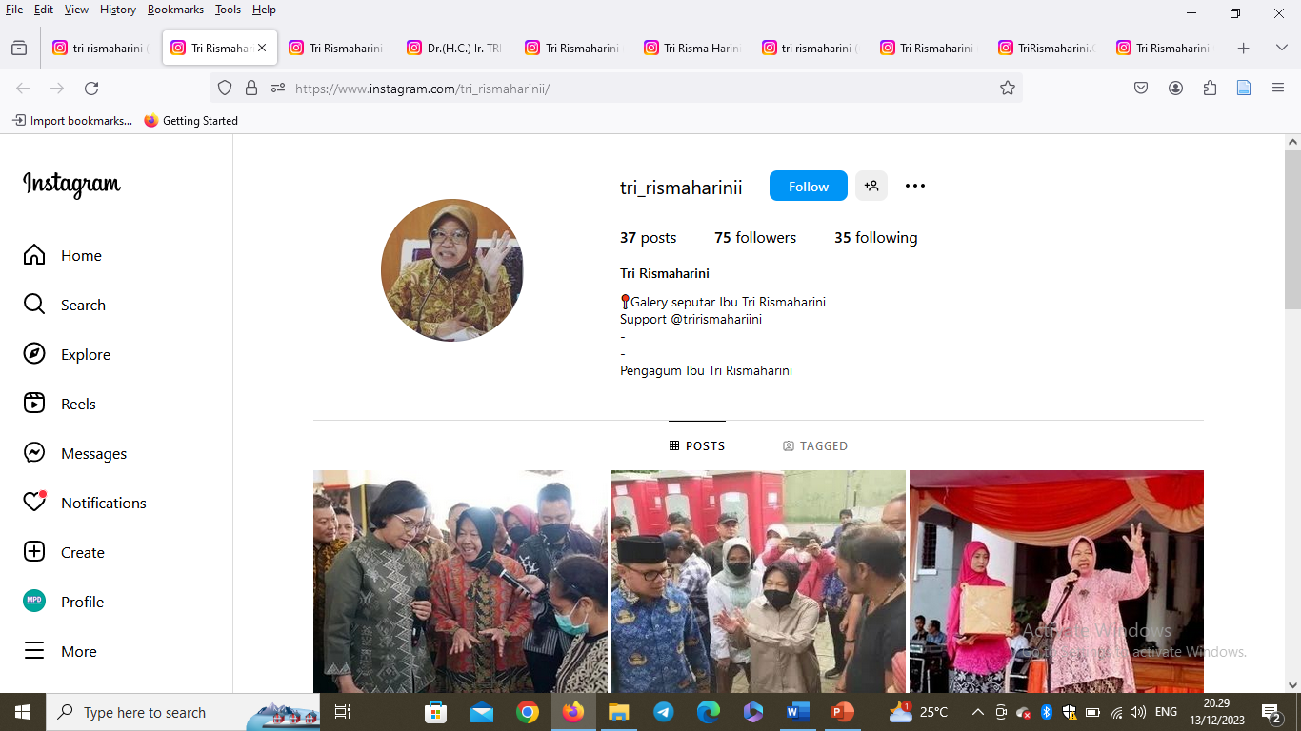
https://www.instagram.com/tri_rismaharinii/

Slide 12
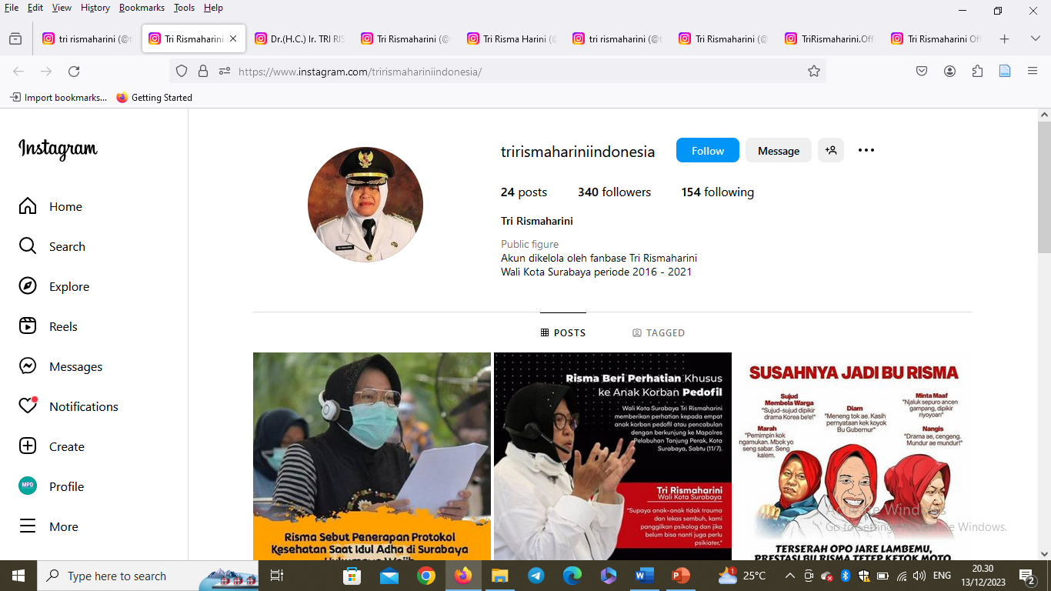
https://www.instagram.com/trirismahariniindonesia/

Slide 13
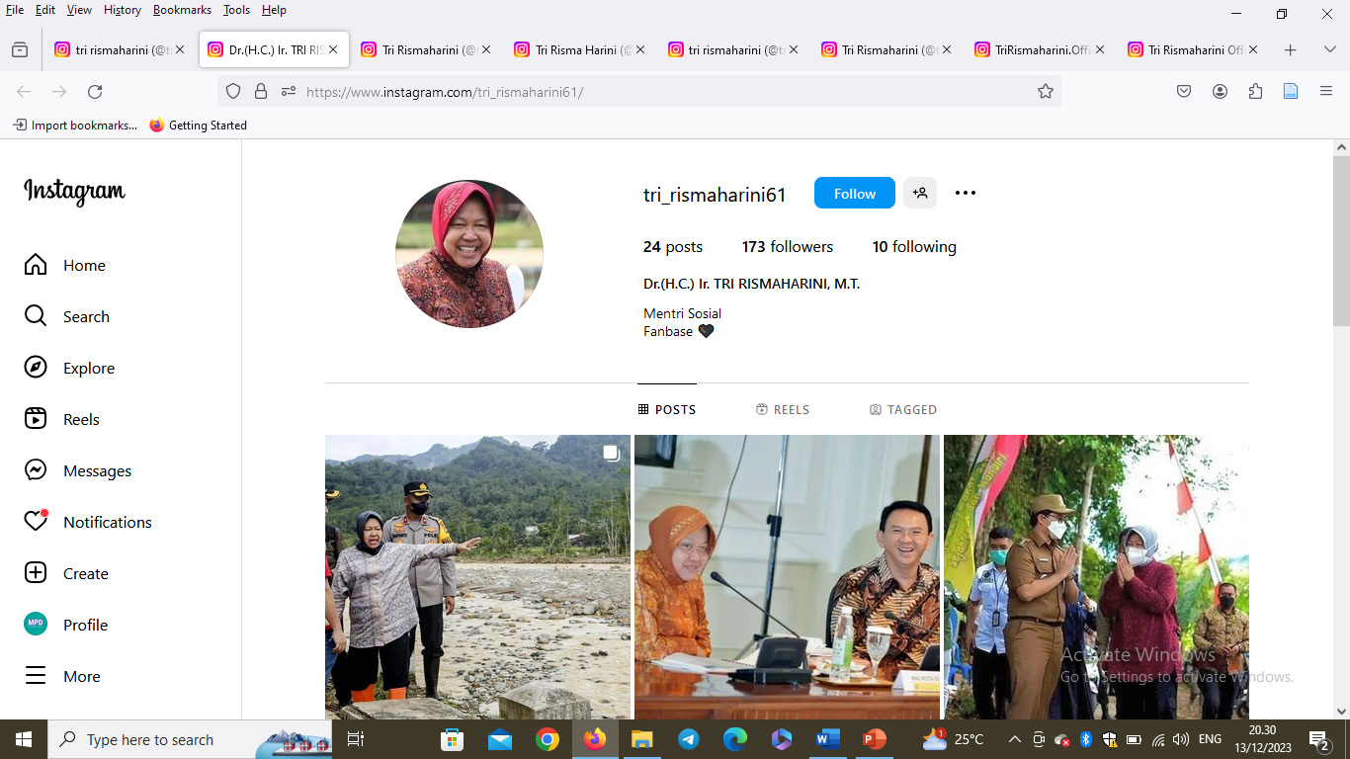
https://www.instagram.com/tri_rismaharini61/

Slide 14
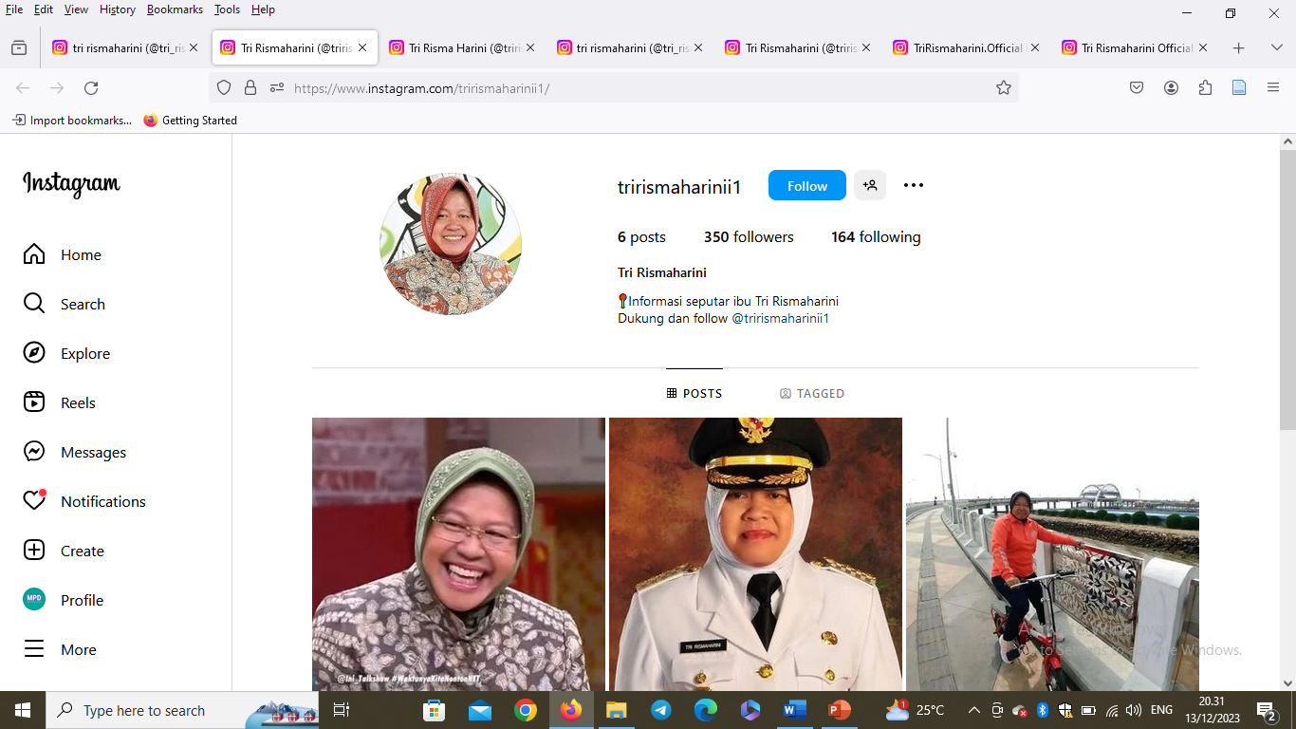
https://www.instagram.com/trirismaharinii1/

Slide 15
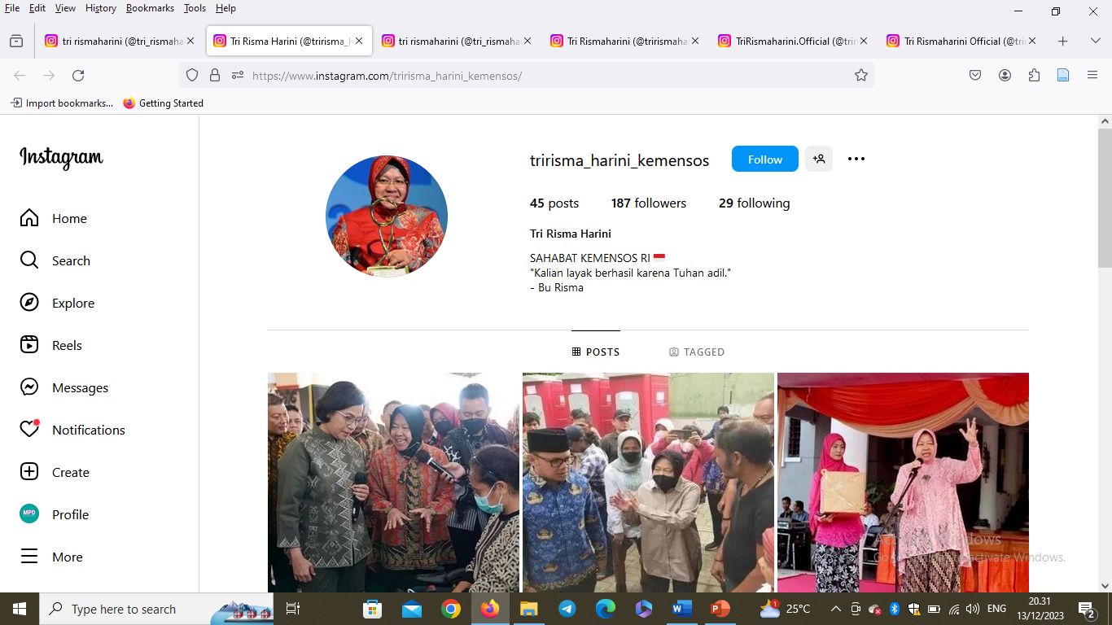
https://www.instagram.com/tririsma_harini_kemensos/

Slide 16
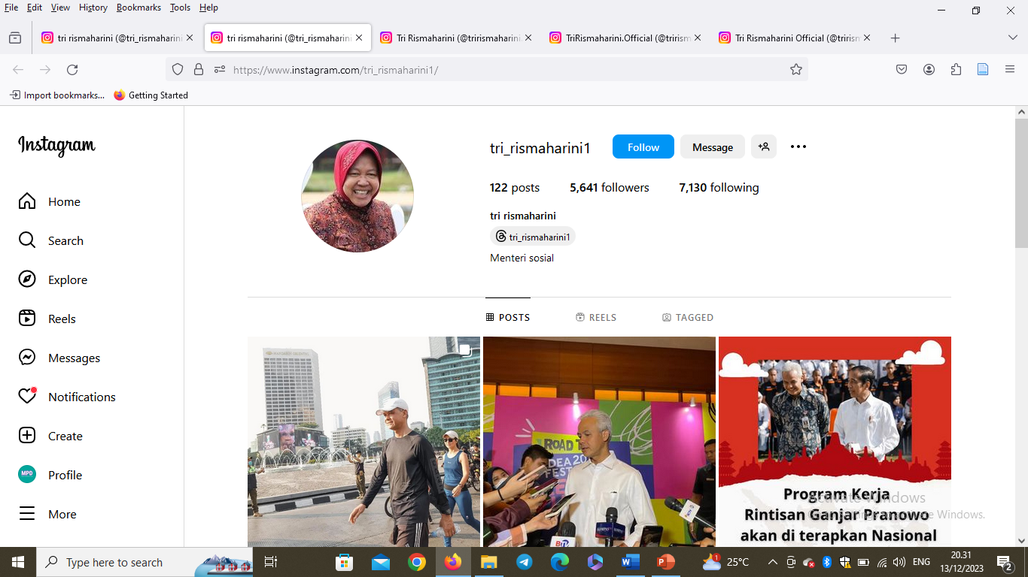
https://www.instagram.com/tri_rismaharini1/

Slide 17
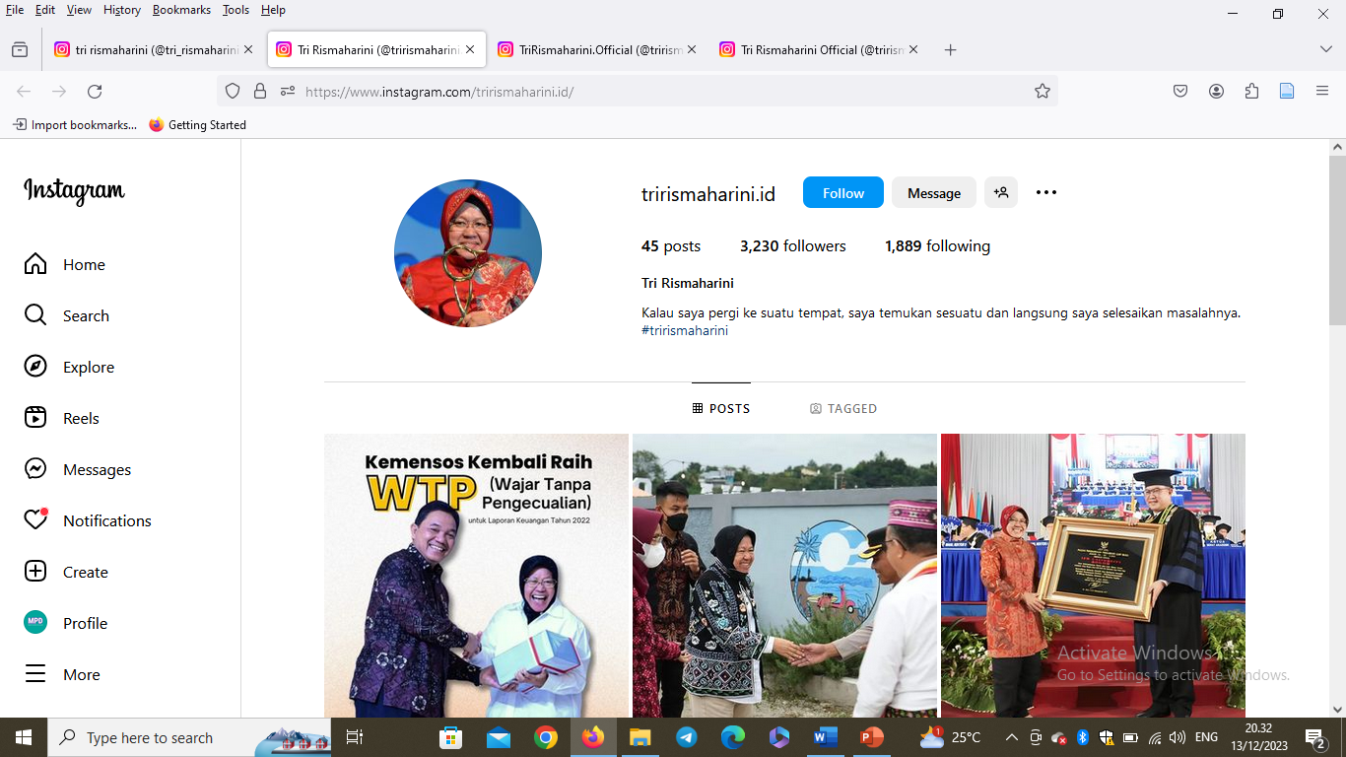
https://www.instagram.com/trirismaharini.id/

Slide 18
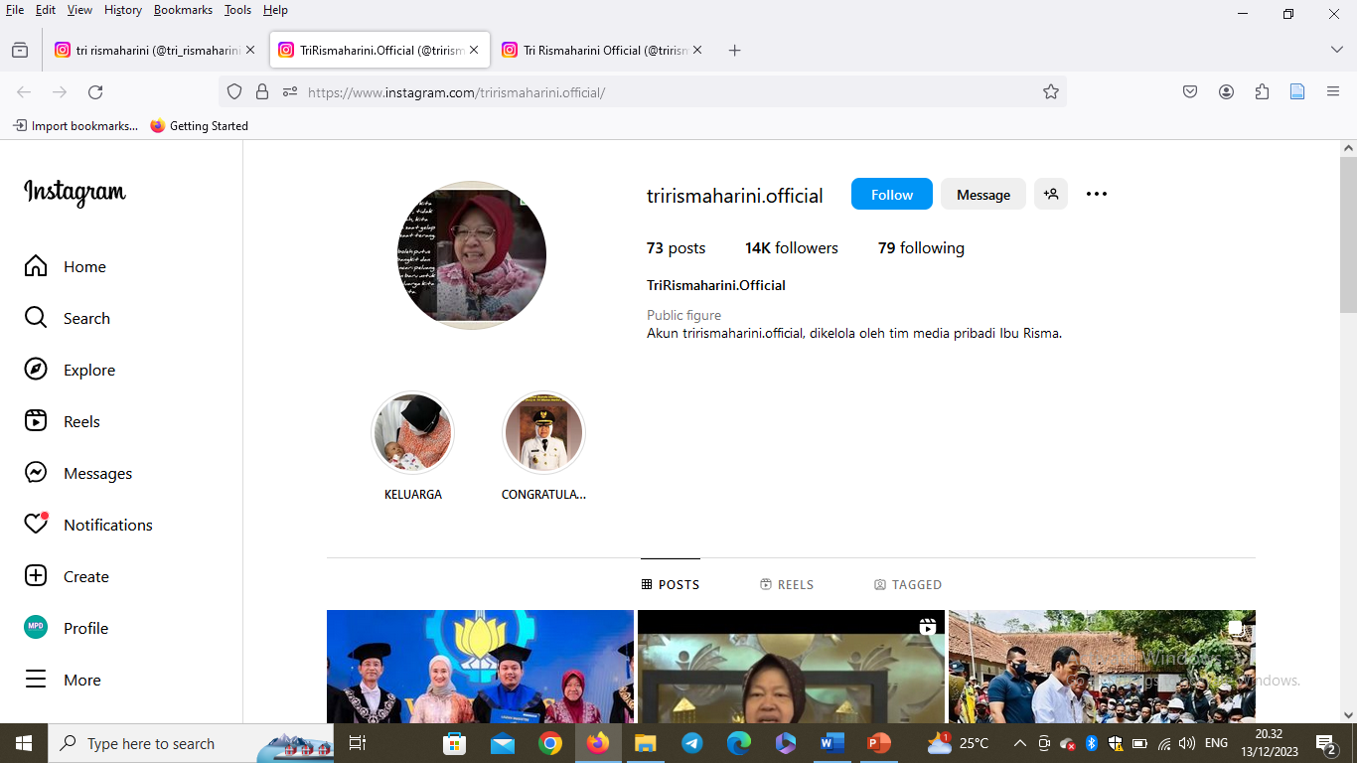
https://www.instagram.com/trirismaharini.official/

Slide 19
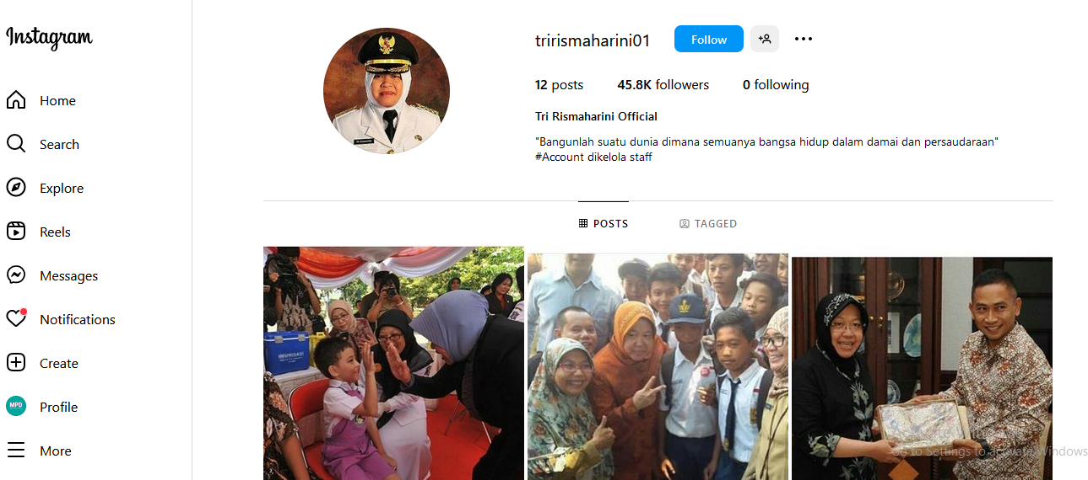
https://www.instagram.com/trirismaharini01/

Slide 20

https://www.instagram.com/tri_rismaharini1/

Slide 21
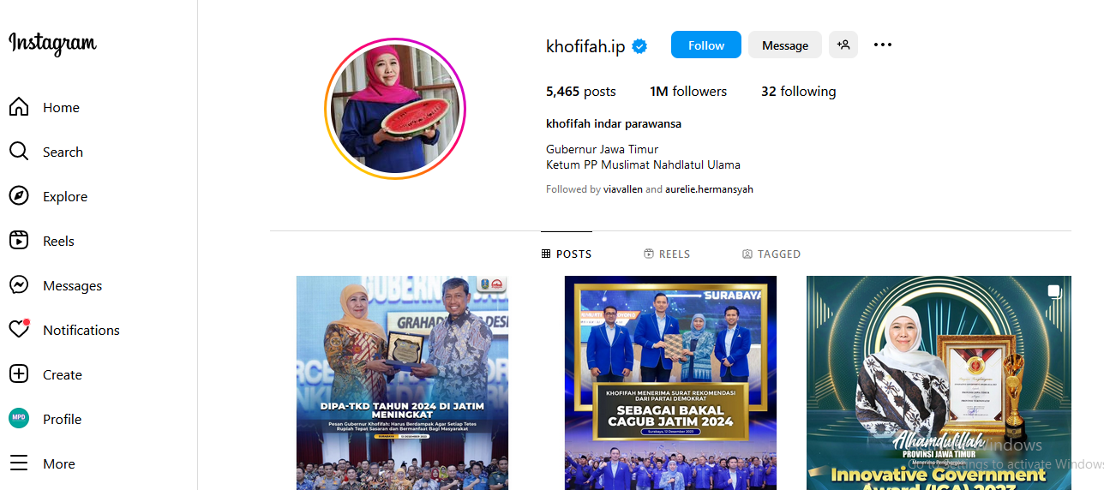
https://www.instagram.com/khofifah.ip/

Slide 22
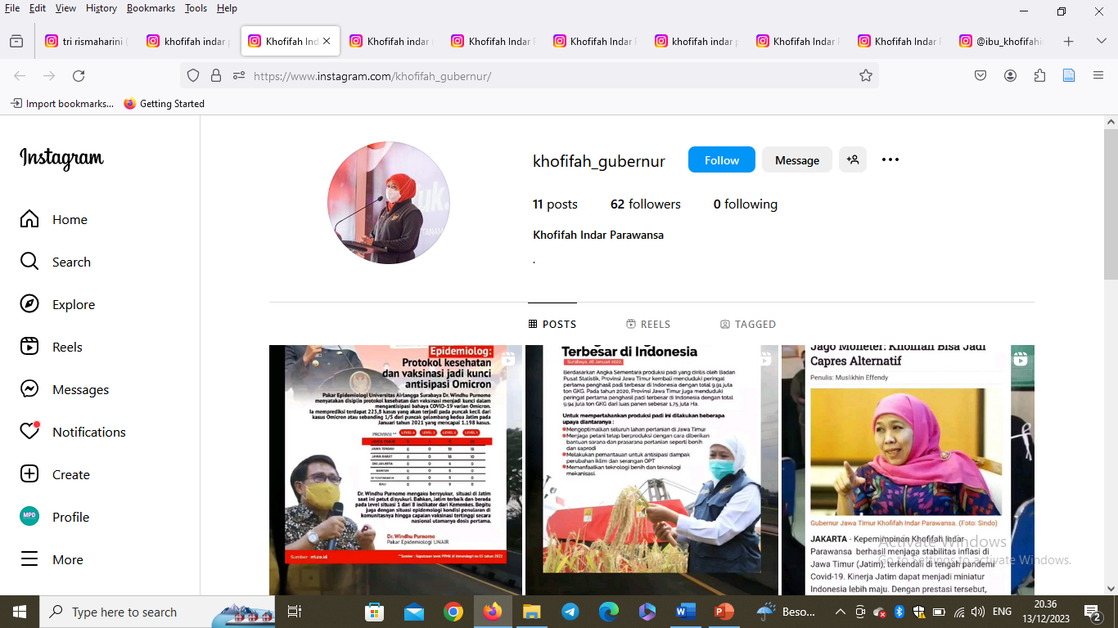
https://www.instagram.com/khofifah_gubernur/

Slide 23
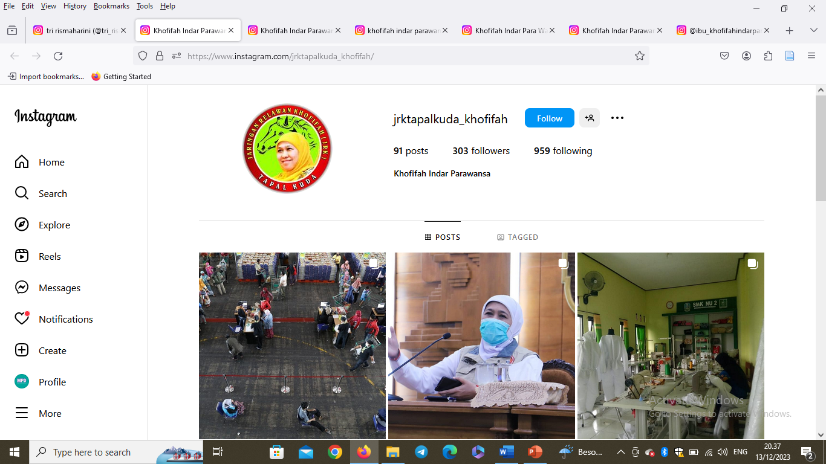
https://www.instagram.com/jrktapalkuda_khofifah/

Slide 24
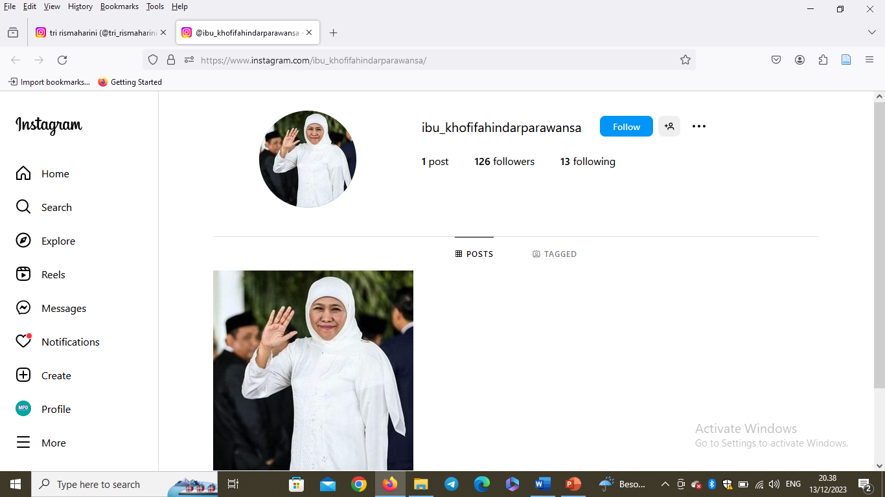
https://www.instagram.com/ibu_khofifahindarparawansa/

